Slide 1

State of the Database
Notes:
Notes

Slide 2
Design and Implementation
Entity Relationship Model
Easier to conceptualize and build
Oracle PL / SQL

Slide 3
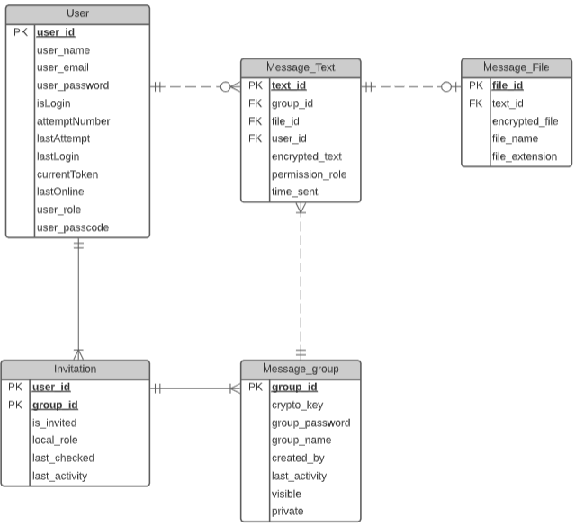
Entity Relationship Model
User
Can send a text or a file
Must be in a group to communicate, one-to-one or otherwise
Message Text / File
Must be sent to a group
Message Group
Can be created for private chats or group chats

Slide 4
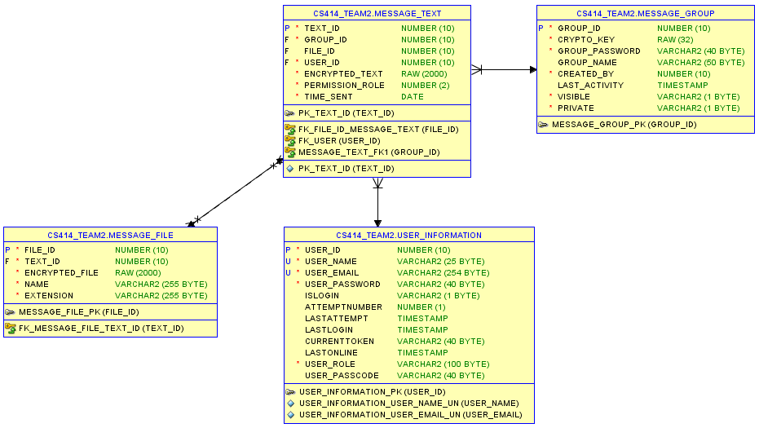

Slide 5
Oracle PL/SQL
Packages
Functions and Procedures
Security
Add a user
Log in and Log out
Messaging
Send message
Get all group messages
Nests
Create group nest
Create private nest

Slide 6
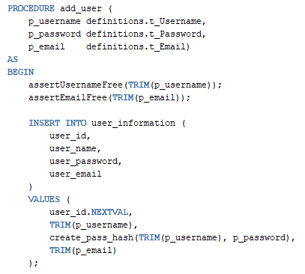
Security Package
User creation
Username – trims white spaces
Varchar2, unique, not null
Email – uses regex for format
Varchar2, unique, not null
Password – stored as hash
Varchar2, not null

Slide 7
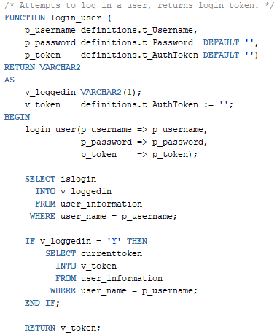
Security Package
Login input information
Username and password
Login output information
Login token (for authentication)

Slide 8
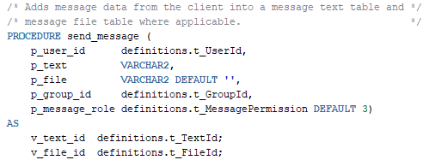
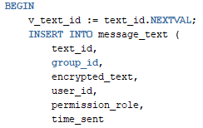
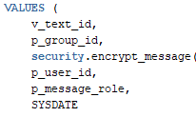
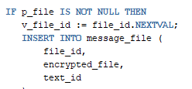

Messaging Package
Sending a message
The file attached is defaulted to null
Checks if a file is included
Values:
Stores encrypted texts and files

Slide 9

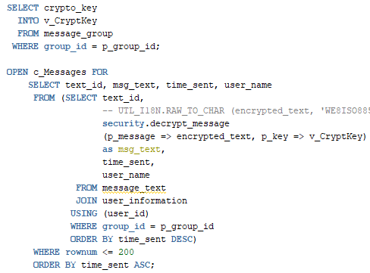
Messaging Package
Viewing messages
Checks if a user is invited to the group
Gets the messages from the message text table and shows the latest set of messages

Slide 10
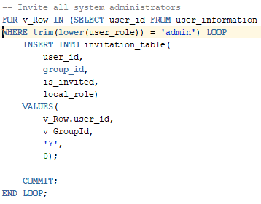
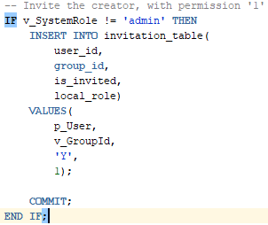
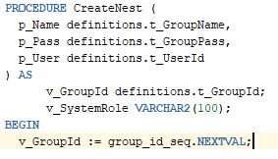
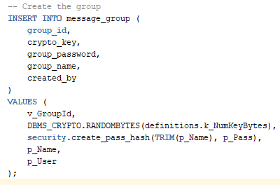
Nests Package
Creating a group nest
For each group, admins are automatically added
The user who created the group will have their role set to ‘1’

Slide 11
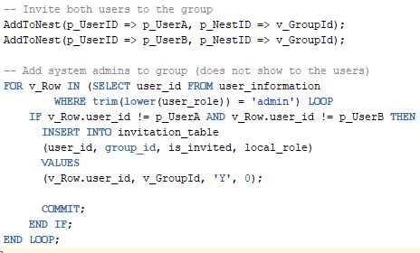
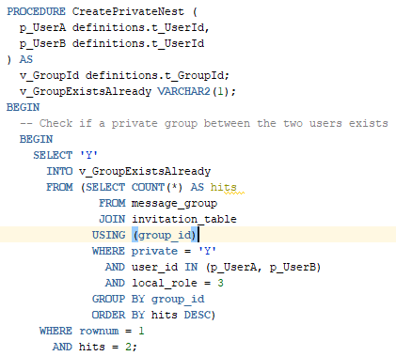
Nests Package
Creating a private nest
Checks if a private nest already exists between userA and userB
Roles for every user in a private nest is set to ‘3’ (default)
Admins are still included into the invitation even in a private nest

Slide 12
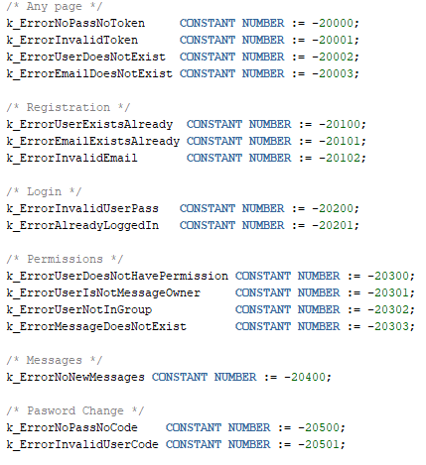
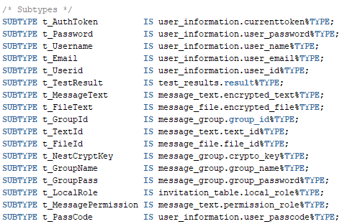
Definitions Package
Standardized error checking
Constants
Regex (email)
Subtypes

